Slide 1
Machine learning
Regent College London
SWE6204

Slide 2
Machine learning
SWE6204

Slide 3

Machine learning
PRINCIPAL COMPONENT
ANALYSIS (PCA)

Slide 4
Module 1 – principal component analysis(PCA)

Slide 5
Learning objectives
Understand dimensional reduction
Understand the Principal Component Analysis

Slide 6
Curse of dimensionality
Many problems can be thought of as having a huge number of “dimensions”
For example, in recommending movies, the ratings vector for each movie may represent a dimension – every movie is its own dimension!
That makes your head hurt. It’s tough to visualize.
Dimensionality reduction attempts to distil higher-dimensional data down to a smaller number of dimensions, while preserving as much of the variance in the data as possible.

Slide 7
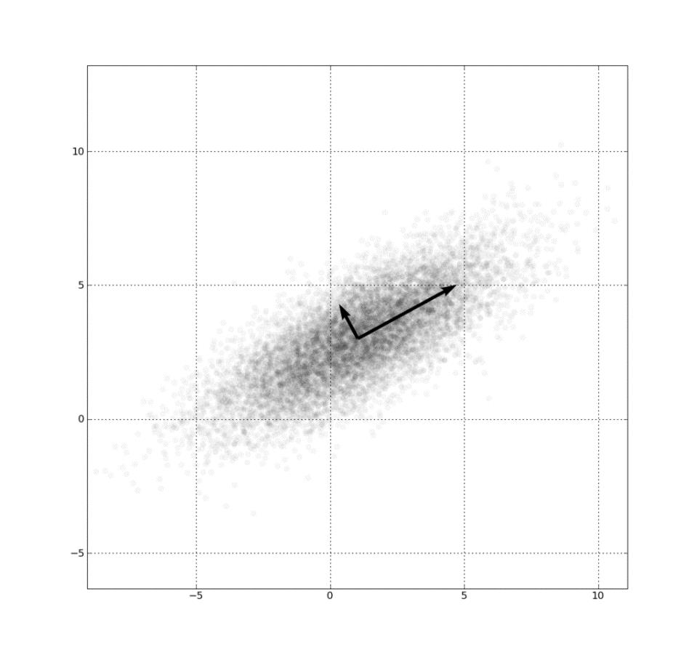
PCA
Involves fancy math – but at a high level:
Finds “eigenvectors” in the higher dimensional data
▫ These define hyperplanes that split the data while preserving the most variance in it
▫ The data gets projected onto these hyperplanes, which represent the lower dimensions you want to represent
▫ A popular implementation of this is called Singular Value Decomposition (SVD)
Also useful for things like image compression and facial recognition

Slide 8

Visualizing 4-D iris flower data
The “Iris dataset” comes with scikit-learn
An Iris flower has petals and sepals (the lower, supportive part of the flower.)
We know the length and width of the petals and sepals for many Iris specimens
▫ That’s four dimensions! Ow.
▫ We also know the subspecies classification of each flower
PCA lets us visualize this in 2 dimensions instead of 4, while still preserving variance

Slide 9
Python coding
Yet again, scikit-learn makes this complex technique really easy.

Slide 10
PCA Overview – Video
Please watch video and identify the difference between PCA & SVM.
https://www.youtube.com/watch?v=kw9R0nD69OU

Slide 11
K Fold cross validation
K Fold cross validation vs Train - test method

Slide 12
+44 (0)207 016 8000
info@rcl.ac.uk

